Slide 1

Episodio 2 – Etiquetado de recursos

Slide 2
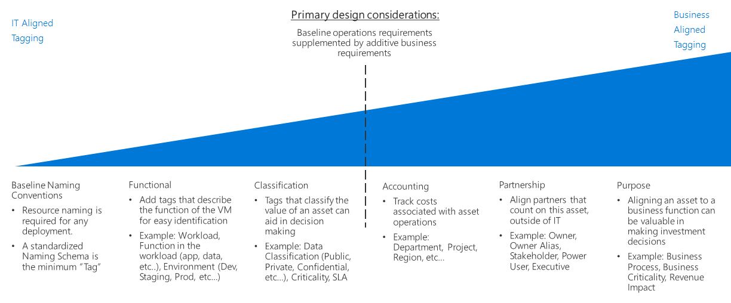
Guía de decisión de Etiquetado
Notes:
Al aplicar etiquetas de metadatos a los recursos en la nube, incluye información que no se pudo incluir en el nombre del recurso. Por ejemplo, incluya información sobre el recurso. Puede usar esa información para ejecutar filtrados e informes más elaborados sobre los recursos. Quiere que estas etiquetas incluyan contexto sobre la carga de trabajo o la aplicación asociadas del recurso, los requisitos operativos y la información de propiedad. Los equipos de TI o empresariales usan esta información para encontrar recursos o generar informes sobre el uso y la facturación de los rhttps://docs.microsoft.com/es-es/azure/cloud-adoption-framework/decision-guides/resource-tagging/ecursos.

Slide 3
Etiquetas mínimas sugeridas
Tag Name | Description | Key | example values
Workload name | Name of the workload the resource supports. | WorkloadName | ControlCharts
Data classification | Sensitivity of data hosted by this resource. | DataClassification | Non-business Public General Confidential Highly confidential
Business criticality | Business impact of the resource or supported workload. | Criticality | Low Medium High Business unit-critical Mission-critical
Business unit | Top-level division of your company that owns the subscription or workload that the resource belongs to. In smaller organizations, this tag might represent a single corporate or shared top-level organizational element. | BusinessUnit | Finance Marketing Product XYZ Corp Shared
Operations commitment | Level of operations support provided for this workload or resource. | OpsCommitment | Baseline only Enhanced baseline Platform operations Workload operations
Operations team | Team accountable for day-to-day operations. | OpsTeam | Central IT Cloud operations ControlCharts team MSP-{Managed Service Provider name}

Slide 4
Otros ejemplos de etiquetas
Tag Name | Description | Key | Example values
Application name | Added granularity, if the workload is subdivided across multiple applications or services. | ApplicationName | IssueTrackingSystem
Approver name | Person responsible for approving costs related to this resource. | Approver | chris@contoso.com
Budget | Money approved for this application, service, or workload. | BudgetAmount | $200,000
Cost center | Accounting cost center associated with this resource. | CostCenter | 55332
Disaster recovery | Business criticality of the application, workload, or service. | DR | Mission-critical Critical Essential
End date of the project | Date when the application, workload, or service is scheduled for retirement. | EndDate | 10/15/2023
Environment | Deployment environment of the application, workload, or service. | Env | Prod Dev QA Stage Test
Owner name | Owner of the application, workload, or service. | Owner | jane@contoso.com
Requester name | User who requested the creation of this application. | Requester | john@contoso.com
Service class | Service level agreement level of the application, workload, or service. | ServiceClass | Bronze Silver Gold
Start date of the project | Date when the application, workload, or service was first deployed. | StartDate | 10/15/2020

Slide 5
Recursos adicionales
Para ampliar información, puedes consultar:
https://docs.microsoft.com/en-us/azure/cloud-adoption-framework/decision-guides/resource-tagging/
https://docs.microsoft.com/es-es/azure/cloud-adoption-framework/ready/azure-best-practices/resource-tagging

Slide 6
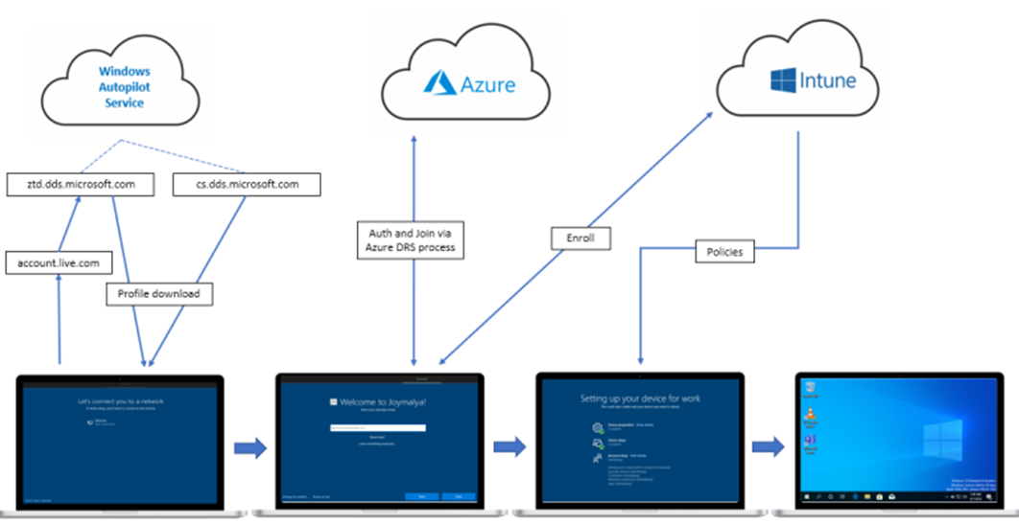
Deployment process – High level

Slide 7
Social Networks
Recuerda que puedes seguirnos en
Twitter - @HablemosdeNube
Telegram - https://t.me/hablemosdenube
Linkedin - https://www.linkedin.com/company/hablemos-de-nube
Web - https://www.hablemosdenube.com
Spotify - https://open.spotify.com/show/5J9HypEa18OLIZ4RSVZ8H2?si=a4cdb488278b4ed6
Google Podcasts - https://podcasts.google.com/feed/aHR0cHM6Ly9hbmNob3IuZm0vcy9hZGZmNzhlOC9wb2RjYXN0L3Jzcw
Youtube - https://www.youtube.com/channel/UCDDawVzg9-2d7hBzwc-TYxQ

